Slide 1
K factor

Slide 2

My Initial Set-Up (TG-51)
Replicated the TG-51 geometry for Co-60 in MC, took voxels approx. equal to cavity radius (0.305)
Ran sim x 10 -> 2.0892E-15 Gy/Particle
Took Aug 2020 source abs dosimetry
k = 9.76 E 14
80 cm
10 cm
10 cm
Dose Rate (SSD =80, 10x10, d=10) = 203.61 cGy/min

Slide 3
Levi’s TGI-51 Measurement
Single run, single voxel
K = 8.78 E14 (smaller than mine)

Slide 4
Levi’s Extended Sweeping w/ Flattening Filter
Using TGI-51 vs “Treatment” rdg ratio to convert dose rate (2020) from TG51 geometery to Treatment
Dose rate = 11.825 cGy/min
Levi modelled sweeping (10 sweeps)
k = 9.94 E 14 (slightly larger than my value)

Slide 5
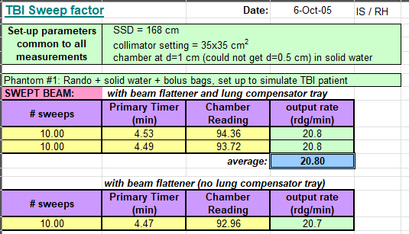
Supporting evidence to increased particles with treatment geometry

Slide 6
Other numbers on the wind
K = 1.17 E 15 (thesis) “Treatment Setup” but 5 sweeps?
K = 1.1531 E 15 (instructions)

